Slide 1
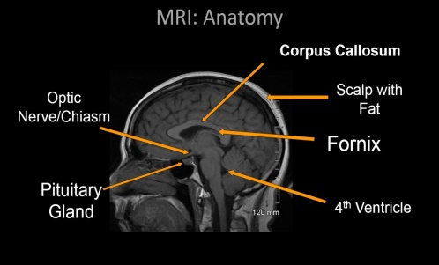
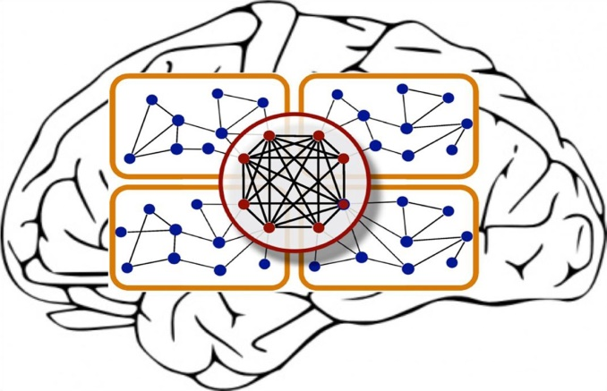
BRAIN TUMOR DETECTION USING
DEEP LEARNING
PRESENTED BY
M. HEMANTH
M. JAYANTH

Slide 2
AGENDA
OBJECTIVE
ABSTRACT
INTRODUCTION
METHODOLOGY
SOFTWARE USED
RESULTS
PERFORMANCE COMPARISON
CONCLUSION
REFERENCES

Slide 3
OBJECTIVE
To provide doctors good software to identify tumor and their causes.
Save patient’s time.
Provide a solution appropriately at early stages.
Get timely consultation.

Slide 4
ABSTRACT
The main idea of this project is to detect the location of brain tumor using (MRI) Magnetic Resonance Imaging and (CT) Computed Tomography scans. The tumor means abnormal cells growth in a human brain.
This technique is carried out in two steps:
First acquire gray scale image from MRI and CT scan images and then comparing the tumor images.
Using CNN(Convolution Neural Network) architecture we find out exact location of the tumor.
CNN(Convolution Neural Network) is used here to study the tumor region of MRI Brain Image in terms of its pixel intensity as it helps in removing the frequency components of edge detected MRI scan image.
In this project we are find out exact position of brain tumor by using Deep Learning.

Slide 5
INTRODUCTION
A brain tumor also known as an intracranial tumor, is an abnormal mass of tissue in which cells grow and multiply uncontrollably, seemingly unchecked by the mechanisms that control normal cells.
Basically a brain tumor is classified into two types:-
Benign(Non-Cancerous).
Malignant(Cancerous).
Detection of tumor is done by performing biopsy, which is one of the conventional method to recognize tumors, it should be performed by radiologist or clinical experts in pathology lab and it also depends on one’s experience. Manual assessment of pathological changes is leading to human errors and time consuming. It is time consuming process and it might lead to some of human error.
So, using our project we can easily identify the tumor within very less time and even minimize the error also.

Slide 6
Contd…..
Cancerous tumor is classified as primary and secondary tumors.
Primary are the ones which emanate from brain tissues and secondary tumors spread from other parts of body to brain. This is called the brain metastasis. Malignant tumor is more harmful as compared to benign tumor as it spreads rapidly in irregular shapes.
If the growth of extra cells becomes more than 50%, then possibility of recovery of patient is optimum. Development in medical imaging technique provides the more opportunity to detect the problem.
MRI and CT scan are the most frequently used imaging technique in neuroscience which provides the deep structure of the brain by creating the 3D images.

Slide 7
METHODOLOGY
Firstly, we have collected the dataset of the Tumor images with the 2 classes (Yes and No).
Necessary pre-processing steps will be completed with the dataset before training with our algorithm.
Once after training the model will be saved for testing and classifying.
User can upload the images of which to be classified and by using the saved model the images will be classified and predicted.

Slide 8
DATA FLOW DIAGRAM
DATASET
PRE-PROCESSING
SPLITTING THE DATA
BUILDING THE MODEL
CLASSIFICATION
PREDICTION OF TUMOR

Slide 9
1. System:
1.1 Create Dataset:
The dataset containing images of the Brain defect images are to be classified is split into training and testing dataset with the test size of 30-20%.
1.2 Pre-processing:
Resizing and reshaping the images into appropriate format to train our model.
1.3 Training:
Use the pre-processed training dataset is used to train our model using CNN, algorithm along with some of the transfer learning methods.

Slide 10
1.4 Classification:
The results of our model is display of tumor images are either with defect or normal
2. User:
2.1 Upload Image
The user has to upload an image which needs to be classified.
2.2 View Results
The classified image results are viewed by user.

Slide 11
CNN
Convolution Neural Network (CNN) is an Deep learning method used to create Image Editing.
ConvNets has successfully identified faces, objects and diagnostics.
The neural convolution network consists of a convolution layer, an Pooling layer, and a fully connected layer, which can perform a different function in the input data.

Slide 12
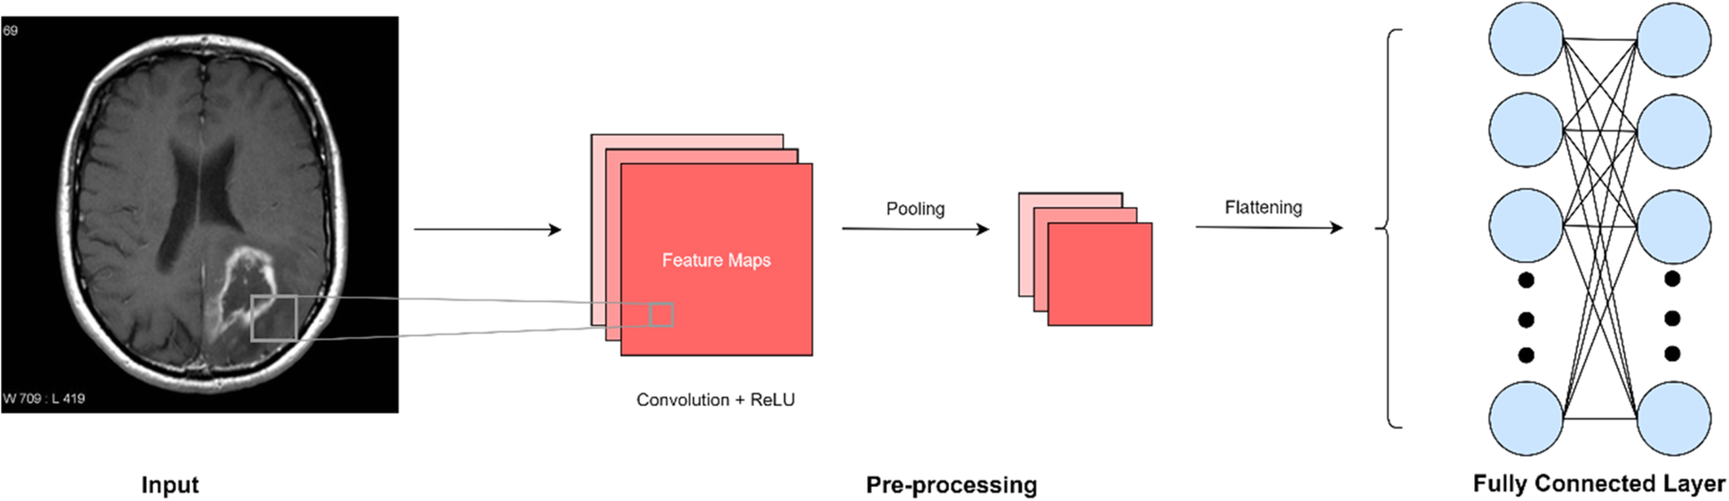
CNN ARCHITECTURE

Slide 13
Convolution Layer : This is the first step in the process of removing elements from an image. The convolution layer has a few filters that can make the convolution work. The whole image is taken as pixel values.
Pooling Layer : Pooling is the down sampling operation that reduces the dimensionality of feature maps. The dimensional of the pooling layer of an input image is 32x32x10. The result of this pooling layer will be in 16x16x10 feature map.
Fully Connected Layers : Input into a fully integrated layer is a product from the last layer of Pooling and convolution, which is then abbreviated and inserted into a fully integrated layer.

Slide 14
SOFTWARE USED
Python:
Python has an abundance of powerful tools prepared for scientific computing Packages like Num-Py, Pandas and Sci-Py area unit freely available and well documented. Packages like these will dramatically scale back, and change the code required to write a given program. This makes iteration fast.
Jupyter Notebook :
The Jupyter Notebook is an open-source web application that enables you to make and share documents that contain live code, equations, visualizations and narrative text. Uses include: data cleaning and transformation, numerical simulation, statistical modelling, data visualization, machine learning, and much more.

Slide 15
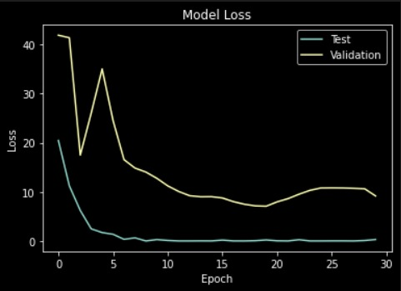
RESULTS
Model Loss

Slide 16
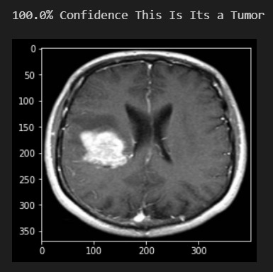
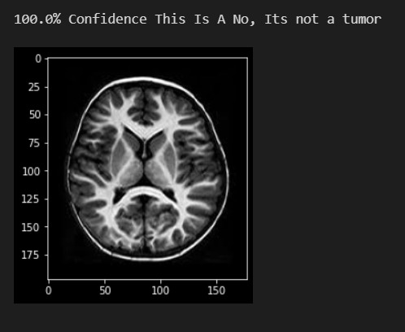

Slide 17
Performance Comparison
Model | Specificity | Accuracy
Traditional Machine Learning Navies' Bayes Random Forest K-Nearest Neighbor Support Vector Machine | 0.9143 0.9050 0.8810 0.9050 | 77.27% 88.63% 84.09% 88.63%
Artificial Neural Networks Convolution Neural Networks | 0.6543 0.4743 | 84.65% 93.4%

Slide 18
CONCLUSION
In brain tumor detection we have studied about feature based existing work.
And also study about deep learning techniques CNN and ANN.
In this system we have detect the tumor is present or not if the tumor is present then model return’s yes otherwise it return no.
We have compared CNN with the ANN. The result of comparison CNN is more accurate than ANN. We obtained the accuracy of CNN in our project is 93%.
However, not every task is said to be perfect in this development field even more improvement may be possible in this application.

Slide 19
REFERENCES
Sajid, Sidra, Saddam Hussain, and Amna Sarwar. ”Brain tumor detection and segmentation in MR images using deep learning.” Arabian Journal for Science and Engineering 44.11 (2019): 9249-9261.
Siar, Masoumeh, and Mohammad Teshnehlab. ”Brain tumor detection using deep neural network and machine learning algorithm.” 2019 9th International Conference on Computer and Knowledge Engineering (ICCKE). IEEE, 2019.
Hemanth, G., M. Janardhan, and L. Sujihelen. ”Design and implementing brain tumor detection using machine learning approach.” 2019 3rd International Conference on Trends in Electronics and Informatics (ICOEI). IEEE, 2019.
Mohsen, Heba, et al. ”Classification using deep learning neural networks for brain tumors.” Future Computing and Informatics Journal 3.1 (2018): 68-71.
Isın, Ali, Cem Direko˘glu, and Melike S，ah. ”Review of MRI-based brain tumor image segmentation using deep learning methods.” Procedia Computer Science 102 (2016): 317-324.

Slide 20


